Slide 1
Tigers East/Alpines East Board of Directors Semi-Annual Web Conference February 21, 2021

Slide 2
Agenda
Welcome
Roll Call
Reports
Old Business
New Business
Adjourn

Slide 3
Reports
Review and approval of August BoD Meeting Minutes
Treasurer’s Report
Membership Report
Website/Editor’s Report
Additional Reports as Required

Slide 4
Treasurer’s Report Rob Harter
Additional supporting documentation found in slides 33 and 34

Slide 5
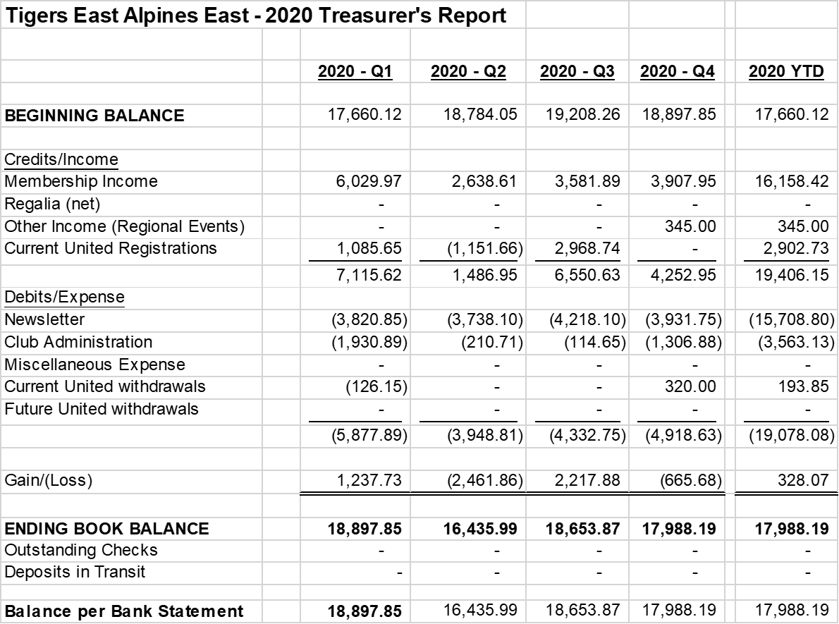
2020 Balance Sheet

Slide 6
Profit/Loss Past Three Years
2020
Ending Balance: $17,988.13
Gain: $328.07 (despite no United income)
Comment: Dues increase and 172 total RR pages key
2019
Ending Balance: 17,660.12
Loss: ($2,743.13)
Comment: Prior to dues increase; 216 total RR pages
2018
Ending Balance: $20,403.25
Loss: ($1,878.22)
Comment: Prior to dues increase; 204 total RR pages
Other observations
Admin expenses constant…about $3.5K
United income important…but not critical

Slide 7
Membership Report Joe McConlogue

Slide 8
Membership Breakdown
497 members (down 17 from August last year)
3 free members:
Jim Morrison. Dave Lawler & Brad Davis
13 courtesy members, added Rootes Archive Center
24 members at Canadian rate for electronic newsletter (down 5 from last August)
Members in 43 states, DC. 5 Canadian provinces, and UK.
No or invalid email for 30 members (6%)
Newsletter selection
179 electronic (34%)
320 printed (66%)

Slide 9
Gains and Losses
2020: Lost 65 members/gained 34 (Net Loss: 31)
Membership Levels 2017-21
2021 – 497
2020 – 510
2019 – 584 (Canadian initiative)
2018 – 501
2017 – 495

Slide 10
Editor/Webmaster Report Kerch McConlogue

Slide 11
Rootes Review
2020 monthly page count and associated costs.
Membership income exceeded newsletter costs.
Managing page count is essential
Month | No. of Pages | Quarterly Cost | Members Dues
January | 12
February | 12
March | 16 | $3,820 | $6,029
April | 16
May | 12
June | 12 | $3,738 | $2,638
July | 16
August | 16
September | 16 | $4218 | $3,582
October | 16
November | 16
December | 12 | $3,931 | $3,907
Total | 172 | $15,709 | $16,158

Slide 12
Facebook March 1 thru August 1
 | 3/1 thru 8/1 2020 (4 mos) | 8/1 thru 2/1 2021 (6 mos)
Total Membership | 509 | 602
Posts | 236 | 311
Comments | 2002 | 25499
Reactions | 2739 | 4684

Slide 13
Virtual Facebook Tour
14 members signed up
3 (plus Joe and Kerch) posted pictures
 | Days | Places | Points
Steve Myers | 1 | 3 | 7
Robert Jaarsma | 1 | 6 | 10
Bill Bulpitt | 9 | 41 | 99

Slide 14
Website: Average Monthly Visits Comparing March 1 thru August 1, 2020 August 1 thru February 1, 2021
Page | Monthly | % of Total
Total visits: 3/1 thru 8/1 8/1 thru 2/1, 2021 | 8076 7960
Home: 3/1 thru 8/1 8/1 thru 2/1, 2021 | 1013 701 | 13% 9%
/login/: 3/1 thru 8/1 8/1 thru 2/1, 2021 | 378 139 | 5% 7%
/rootes-reviews/: 3/1 thru 8/1 8/1 thru 2/1, 2021 | 195 132 | 2% 2%
Total forum: 3/1 thru 8/1 8/1 thru 2/1, 2021 | 1823 1793 | 23% 27%

Slide 15
Additional Reports Keep reports to 2 minutes

Slide 16
Old Business
Insurance
Update on Paid Advertising
SUNI Update
Preservation Class

Slide 17
Insurance
Current - J.C. Taylor
Up for renewal 19 Mar 21; Premium $1068
Premium costs last three years
2018: $1300
2019: $1250
2020: $1044
Covers only static events – No AutoX coverage
Looked at Hagerty last year…less coverage for more money
Recommend we renew…we have not held our own autox since 2013. Buy it separately, if needed.

Slide 18
Advertising Revenue Update
Packets sent USPS
British Wiring (signed up for 12 issues)
Paul’s Chrome Plating
Classic Sunbeam
White Post Restorations
Packets sent by email 1/31
L&T Vintage
MacGregor
Packets by email 2/11
Treasured Motor Cars
Vintage Restorations
Race Ramps
Also by USPS
Sunbeam Specialties
Apple Hydraulics
Condon Skelly Insurance
Eastwood
K&T Vintage
JC Taylor
Librandi’s Plating
Ragtops&Roadsters
Moss Motors

Slide 19
SUNI Update
Host Hotel: Hilton Garden Inn Hotel Independence, MO. Room rate $109.00/night
COVID still a concern but we continue to plan
Key target dates
Apr 1st Registration Opens
June 1st Date we must commit $$$. Will evaluate expected attendance and COVID conditions
Aug 14th Last date to cancel and reschedule for 2022

Slide 20
SUNI Update
Tentative Schedule

Slide 21
SUNI Update
Invited Guests:
Rosemary Smith: Rootes rally/race driver
Mike Jones: Jensen Manager
John Nikas: Noted auto historian/author
Lord Rootes
Activity assignments
Kerch handling registration
STOA will likely run autocross
Plan to volunteer TEAE to run concours

Slide 22
Preservation Class Award
Board approved Bumper badge @ Aug Meeting
Eliminate 3rd Place award: 185/200 for 1st and 175/200 for 2nd
Rallye Productions:
Thick heavy duty material like brass requires custom order…expensive. Cheaper alternative: Thin aluminum badges similar material to dash plaques…50 minimum
Quality Lapel Pins:
Will make 10 of each. Thick steel 3x2 silkscreen; $17 ea + shipping and set up. $550 total
Rather than maintain inventory we could custom order as part of United prep based on # of entries.

Slide 23
New Business
Rootes Archive Donation Funding
United 2022
United Chairperson Courtesy
Publish Printed Roster
Membership Incentives
Regional Reporting
Parts Sales via Website

Slide 24
Rootes Archive Donation
$1,200 donated at the end of 2020. We spoke of how we can recoup $$$$.
Recommend we not take any action to “recoup” funds, but rather focus on way to offset future donations…Our donation should not come at the expense of the services we provide our members
Propose: Voluntary donation by individual member at time of registration or renewal. That money set aside for annual club donation.
Other ideas?
Way forward?

Slide 25
United 39 (2022)
If SUNI proceeds, we need to begin serious planning this summer.
Possible venues
Canada
North Carolina
Other???

Slide 26
United Chairperson Courtesy
Board member Barb Geshke proposes:
To thank/reward the individual who volunteers for and serves as the United Chairperson, registration fee for the event is waived
Discussion
Motion?

Slide 27
Printed Roster
Board member Joe McConlogue proposes:
We consider publishing a printed roster
Printing and mailing costs
Printing/mailing estimate: $2K minimum…more depending on how much we include in roster and resulting number of pages
Discussion
Way forward

Slide 28
Membership Incentives
Board member Joe McConlogue recommends:
We contact lapsed members and offer membership fee discount to renew
Questions to consider
How far back?
How do we reach out? Phone? Email? Mail?
CAT just did this (no discount) via phone
Outreach costs?
How much discount?
Discussion?
Way forward?
Other incentive ideas???

Slide 29
Regular Regional Reports
Board member Dave Reina proposes:
Regional Reps be tasked to send in regular reports on activities in their area.
Promotes sharing experiences club wide
Other clubs do this successfully
How often? Negative reports required?
Discussion
Way forward?

Slide 30
Parts Sales via TEAE Website
Parts Sellers are reportedly leaving ebay and other online sites due to government regulations and tax consequences
Can TEAE and its web domains provide an alternative?
Concept of Action
Create an enhanced classified area on the website, or use one of the domain names we own, where individuals can list and sell items
Advertise it in the Rootes Review and on Facebook
Listing on the website and related advertising in the Rootes Review is free
TEAE gets one percent (1%) commission from seller on each sale. Two (2%) percent for non-members
Discussion
Way Forward?

Slide 31
Wrap Up
Any other items to Discuss?
Motion to Adjourn

Slide 32
Back-up Slides

Slide 33
2019 Balance Sheet

Slide 34
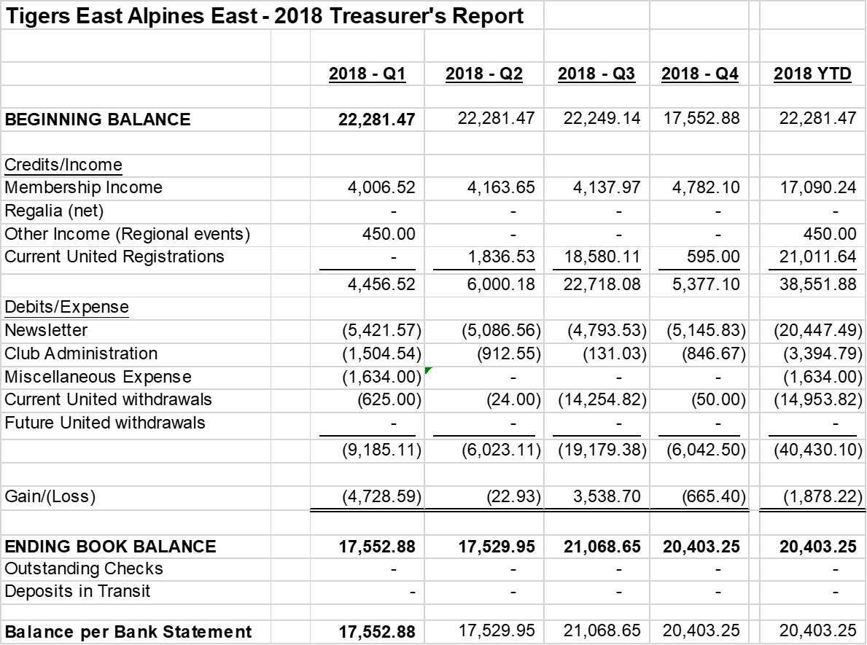
2018 Balance Sheet

